Slide 1

INFO5100 Application Engineering And Development
CELLULAR MOBILE DONATION

Slide 2

PROBLEM OVERVIEW
In today's interconnected world, smartphones have become ubiquitous in many societies. But a significant digital divide persists, leaving marginalized communities without the crucial means to connect, learn, and participate in the opportunities of the modern age. This glaring disparity is precisely what mobile donation drives seek to address.
By recognizing the transformative power of mobile technology and the impact it can have on education, employment, healthcare, and emergency preparedness, these initiatives aim to bridge the gap and empower those who have been left on the fringes of the digital era.

Slide 3
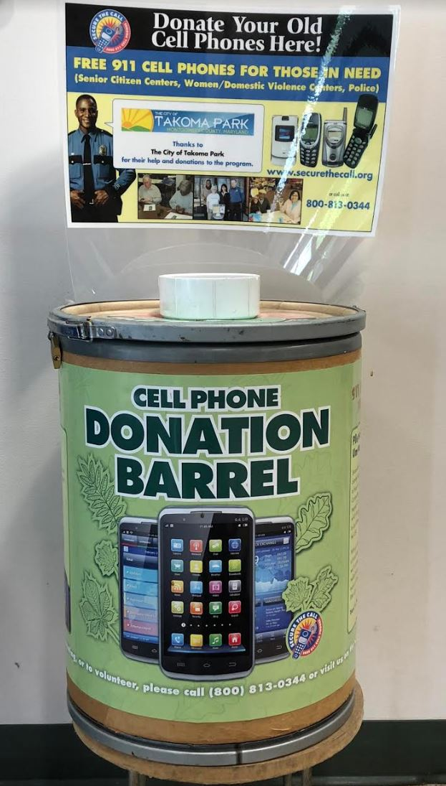
Proposed Solution
Mobile Donation Platform is a powerful ecosystem application empowering individuals to seamlessly contribute their devices, bridging the digital divide by providing to individuals or organizations in need.
The main purpose of this application is to drive an initiative that aims to address the social and humanitarian issues by providing communication tools to those who may not have access to them.
The application facilitates a streamlined solution where donors, comprising individuals, universities, and companies, contribute mobile phones which go to the centralized central hub. Subsequently, the devices undergo quality assurance checks at the inspection hub to determine their condition. Functional devices return to the central hub for distribution to those in need, while non-functional ones are directed to the scrap hub for proper disposal and recycling. The logistics component also plays a crucial role in transporting the mobile phones throughout this process.

Slide 4
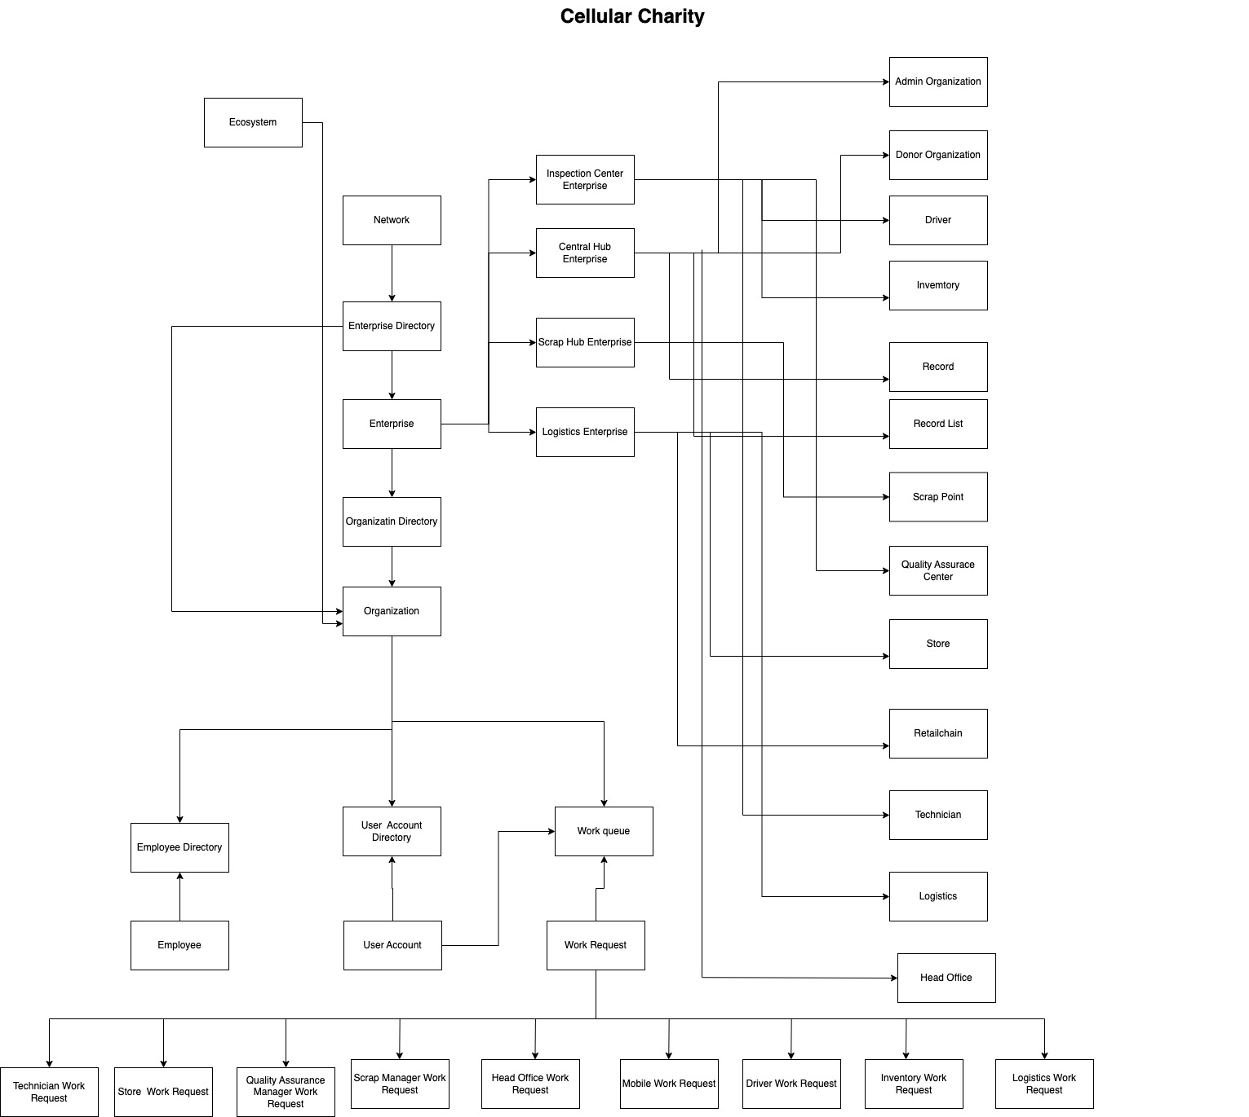
UML Diagram

Slide 5
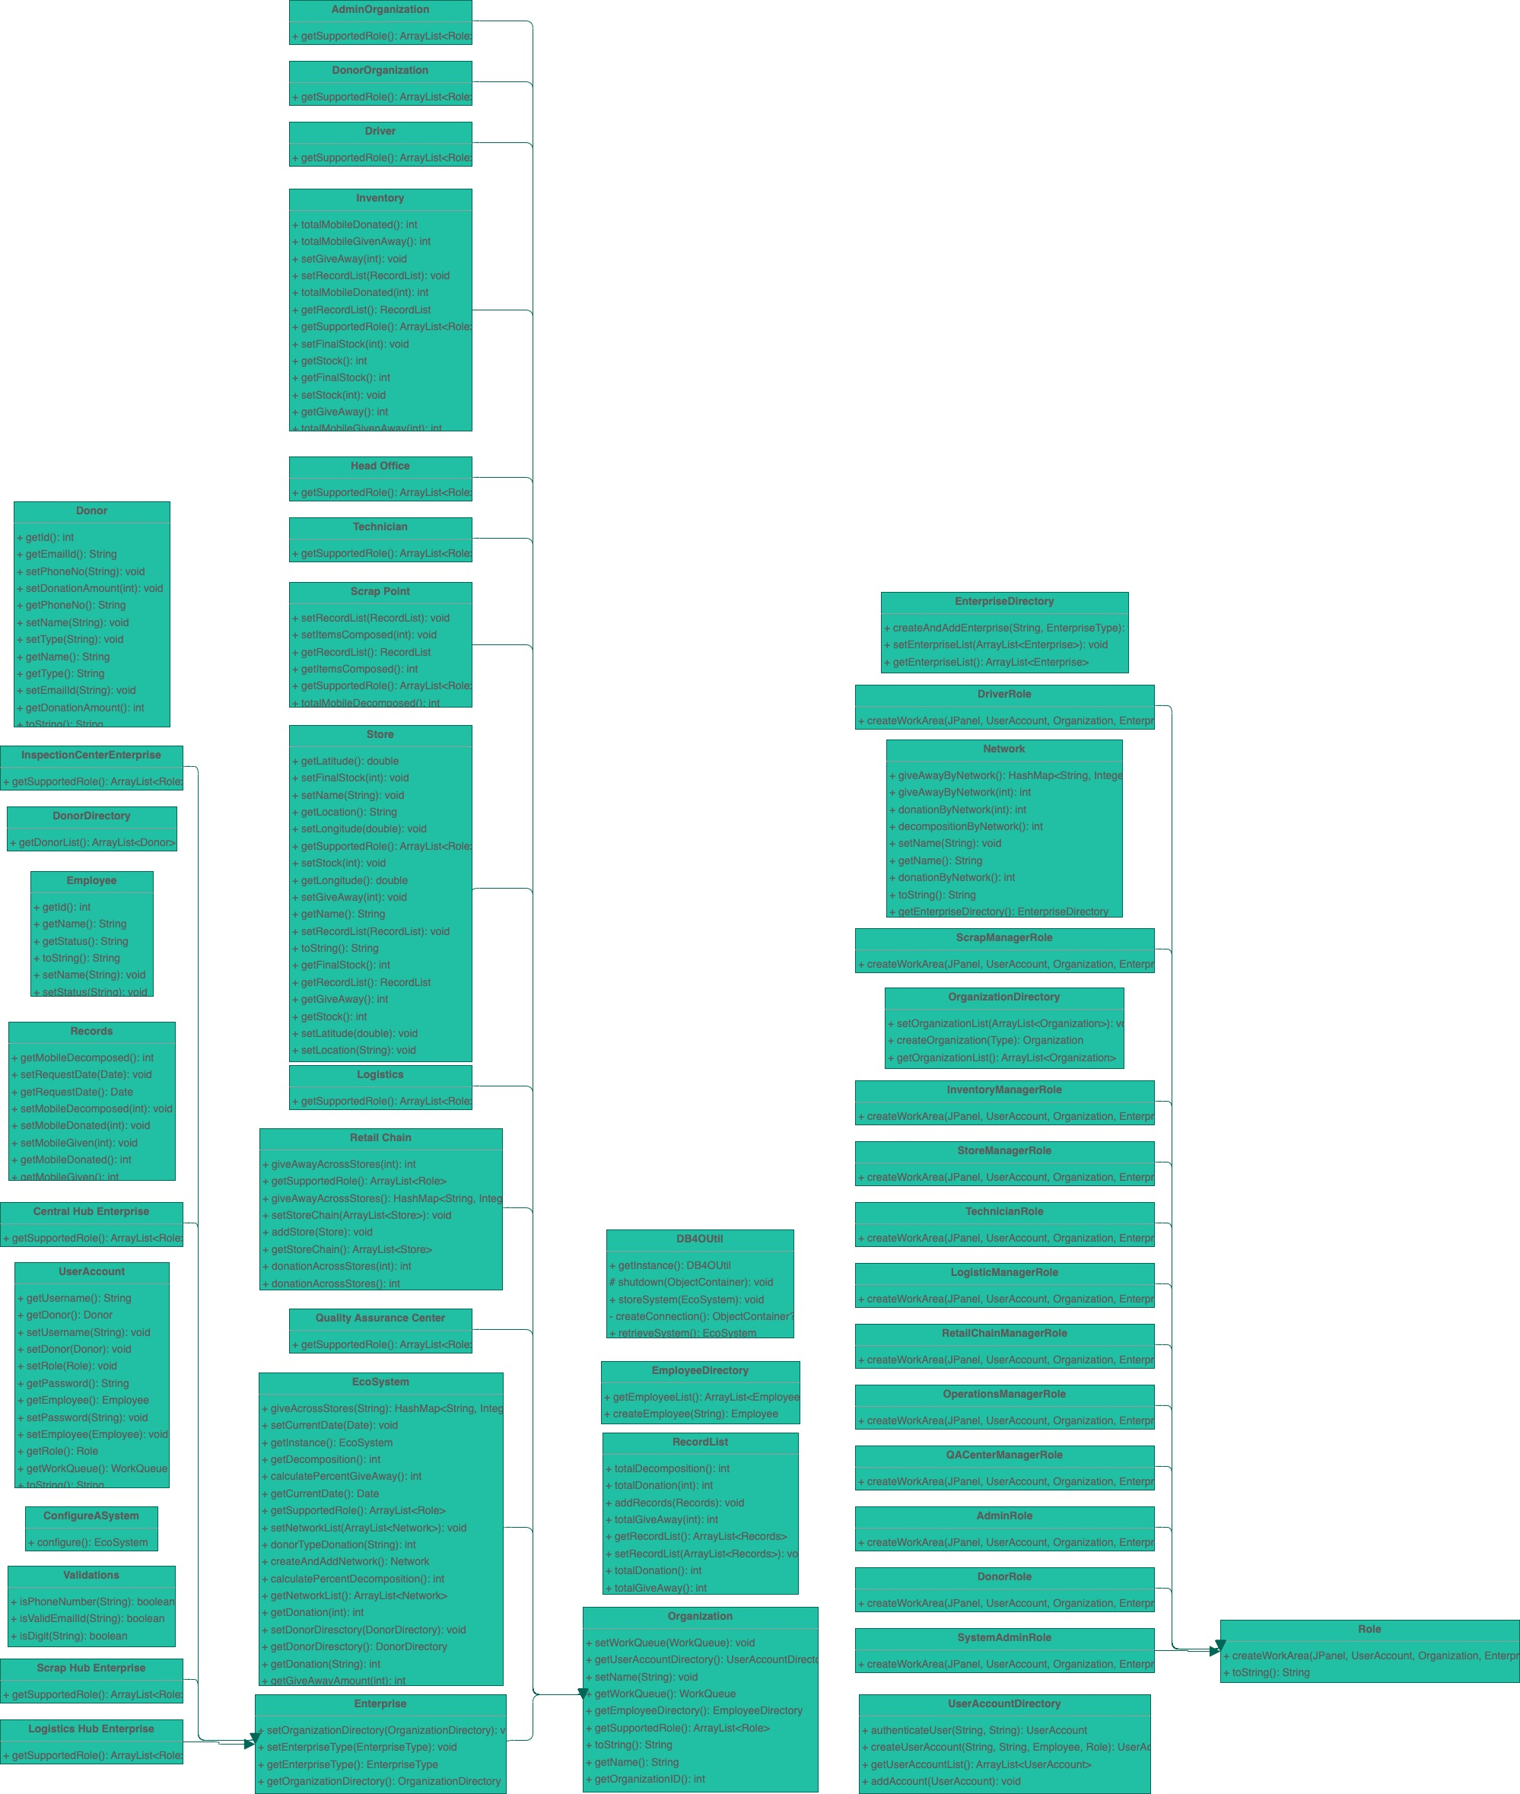
UML Diagram

Slide 6
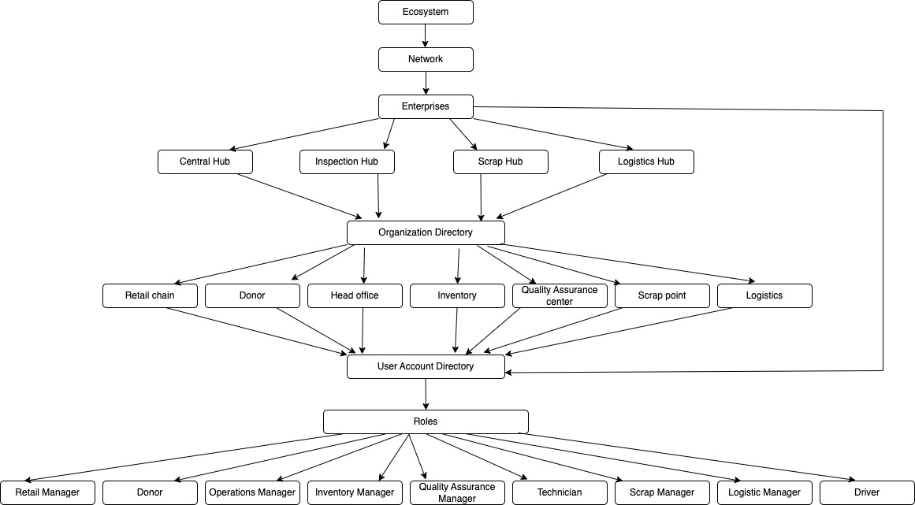
Ecosystem architecture Diagram

Slide 7

List of Enterprises
Central hub
Inspection Hub
Scrap Hub
Logistics Hub

Slide 8

USE CASES
Central hub ENTERPRISE
Cental hub is a centralized platform which functions as the heart of the mobile donation ecosystem.
Mobile phones donated by individuals, universities, and companies are directed to the central hub, encompassing the main office. Here, the inventory is updated as the devices are categorized by network and allocated to respective retail stores.
Subsequently, the mobile phones proceed to the inspection hub, housing the quality assurance center.
Functional devices approved in this phase are then returned to the retail stores.
These retail outlets actively participate in the donation process by contributing to individuals and NGOs in need.
Additionally, a unique feature enables stores with insufficient inventory to request stock from other stores, displaying store names and distances for efficient inventory management.

Slide 9
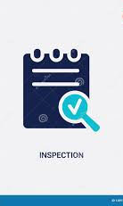
USE CASES
Inspection hub ENTERPRISE
The Inspection hub is dedicated to assessing donated mobile devices.
It conducts thorough assessments of donated mobile devices, ensuring they meet quality standards.
Plays a pivotal role in refurbishing functional devices, conducting necessary repairs, and preparing them for distribution to recipients in need.
Non-functional or outdated devices are directed to the scrap hub.

Slide 10

USE CASES
Scrap hub ENTERPRISE
A scrap hub will be responsible for the proper disposal and recycling of unusable or outdated devices.
Non-functional or outdated devices are directed to the scrap hub, where they undergo proper disposal and recycling.
This hub will also adhere to environmentally sustainable practices, contributing to responsible electronic waste management and reducing the ecological impact of discarded devices.

Slide 11

USE CASES
Logistics hub ENTERPRISE
The logistics system facilitates the seamless collection of donated devices from diverse locations, ensuring timely transportation to the individuals and NGOs as required.
This efficient transportation network is vital for the success of the entire mobile donation initiative, optimizing the flow of devices through each stage of the process.

Slide 12

List of Organizations
Retail Chain
Donor
Head Office
Inventory
Quality Assurance Center
Scrap Point
Logistics

Slide 13

List of Roles
Retail Manager
Donor
Operations Manager
Inventory Manager
Quality Assurance Manager
Technician
Scrap Manager
Logistics Manager
Driver

Slide 14
Thank you!

